Slide 1
Data Structure and Algorithm DSA

Slide 2
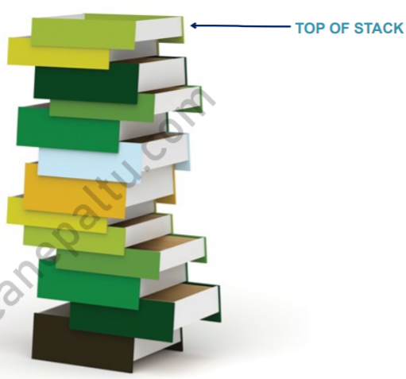
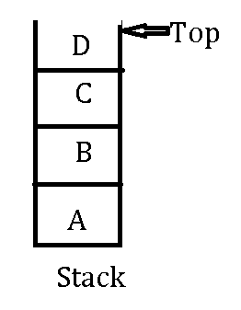
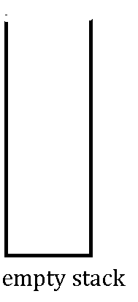
Stack-
Stack is order collection of items in which insertion and deletion are perform at one end called Top of Stack(TOS).
As all the deletion and insertion is perform from top of the stack, the Last added element will be first to be removed from the stack(LIFO).
Eg: Play trays, pile of books etc.

Slide 3
Stack Implementation
Static Implementation :
Stack can be implemented using array. In this method (using array), this data structure of stack is not efficient as over estimate or under estimate can occur. But static implementation is easy method of creating stack.
Dynamic Implementation :
Dynamic Implementation of stack is also called linked list representation. It uses pointers to implement stack type of data structure.

Slide 4
Stack as An ADT(Abstract Data Type)
Abstract Data Type is such data type which is define by operation perform on them.
Values: Order list of items
Properties: Zero or more items are added and deleted from one end or TOS
Operations:
-Determine the stack is empty or not.
-Determine the stack if full or not.
-If the stack is not empty , then retrieved the item from its top.
- If the stack is not full, then insert a new item at one end of stack called top.

Slide 5
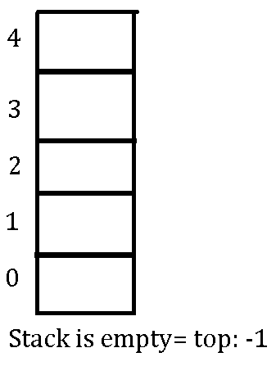
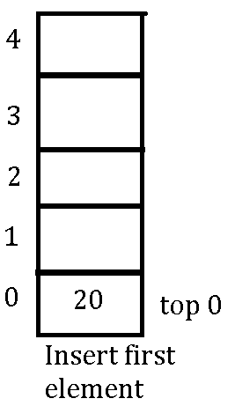
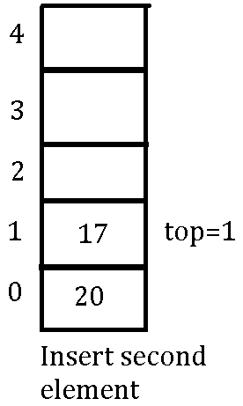
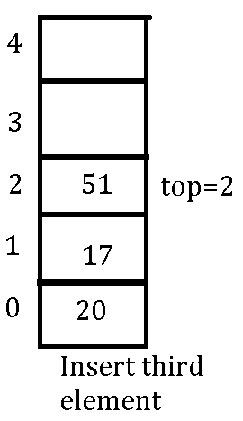
Inserting Element in Stack-push

Slide 6
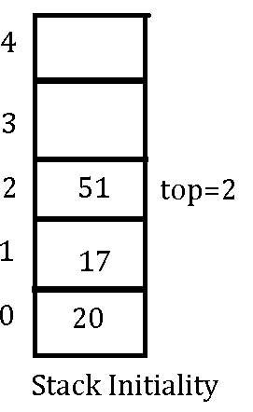
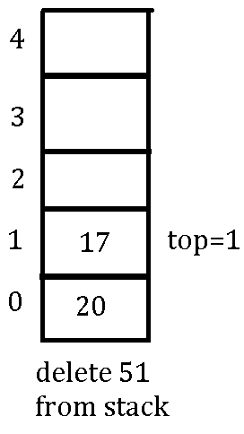
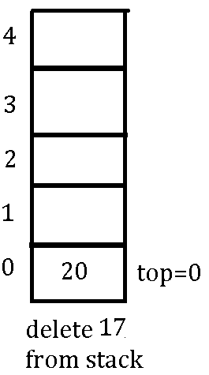
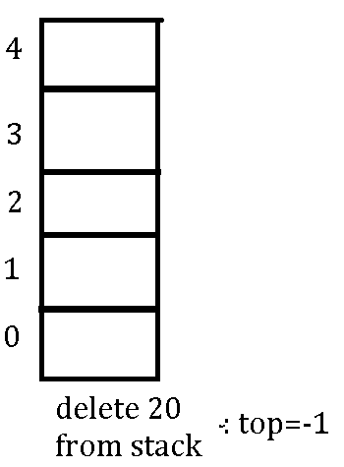
Deleting Element in a Stack- pop

Slide 7
Stack Terminology:
Context : The environment is which a function execute. Includes : Arguments, local variables, global variables
Stack frame : The data structure containing all the data (arguments , local variables return address, etc.), needed each time a procedure or function is called.
MAXSIZE : Term used to refer maximum size of stack.
TOP : It is used to check stack overflow or underflow conditions. Initially TOP stores -1. Whenever an element is added to the stack the TOP is first increment and then the item is inserted into the location currently indicated by the TOP

Slide 8
Stack : An array of size MAXSIZE.
Stack Overflow : The situation when the stack becomes full, and no more elements can be pushed onto the stack . At this point top is present at the highest location of stack.
Stack Underflow : The situation when the stack contains no element . At this point top lies at the bottom of stack.

Slide 9
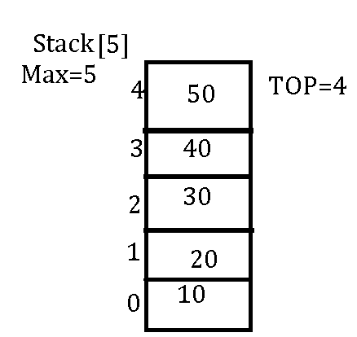
Algorithm-Push
To insert an element to the stack:
Let stack [MAX size] is an array for implementing the stack
Push(stack[MAXSIE], TOP,VALUE)
1. [Check for stack overflow]
If TOP=MAX-1THEN
Print”overflow: stack is full” & Exit.
2. Set Top=Top+1=3+1=4(increase top by 1)
3. Set Stack[top]= value(inserts item
in new top position)
4. Exit.

Slide 10
Algorithm : POP
POP(Stack[],Top)
1. Check for the stack underflow
IF TOP=-1THEN
Print “underflow-Stack is empty”
Else
Set item = Stack[TOP]
2. Top=TOP-1 (Decrement the stack top)
3. Return the deleted item from the stack.
4. Exit.

Slide 11
Application of Stack:
A stack is useful to solve typical problems like checking validating of an expression, balancing the symbols in an expression, reverse the directly and indirectly in the following field :
To convert infix expression to prefix and postfix.
To evaluate the expression (prefix, postfix)
To keep the page visited history in a web browser to perform the undo sequence a text auditor.
To perform recursion function.
To be used as auxiliary data structure for implementing algorithms.
To be used as components of other data structure.

Slide 12
The Infix, Postfix and Prefix
Infix Notation: A2-B2 = (a-b )*(a+b)=(ab-)*(ab+)= ab-ab+*
The infix notation is what , we come across. In our general mathematics where the operation is written in between the operands. Eg: A+B(+ is infix)=
Prefix: The prefix notation is the notations in which the operator is written before the operands. Eg: +AB
Postfix : The postfix is the notation in which operator is written after the operands. Eg : AB+
Prefix and postfix notations are free of precedence rule. So parenthesis is not required in this notation. This notation are used to solve expression more efficiently than infix notation.

Slide 13
Notation Conversion:
Let us take an example of following infix operation of 2 + 3 * 3 .=
If we compute this we will get following result 5 * 3 = 15. Is it right? No, So what is wrong?
We should have knowledge about precedence rule to get correct result.
Here multiplication have higher precedence than addition, so it should perform before addition.

Slide 14
Operator Symbol Precedence
Exponential ^, $ Highest
Multiplication /Division, *, / Next Highest
Addition/Subtraction +, - Lowest

Slide 15
INFIX TO POSTFIX
INFIX TO PREFIX
A*B + C/D
= (A*B)+(C/D)
= (AB*)+(CD/)
=AB*CD/+
(A+B)*C/D+E^F/G
= [(AB+)*C]/D+(EF^)/G
=(AB+C*)/D+(EF^G/)
=(AB+C*D/)+(EF^G/)
AB+C*D/EF^G/+
A*B+C
(A*B)+C
(*AB)+C
+*ABC
A/B^C+D
A/(B^C)+D
A/(^BC)+D
(/A^BC)+D
+/A^BCD

Slide 16
Algorithm to Convert Infix Notation into Postfix:
Suppose Q is an arithmetic expression written in infix notation. The algorithm finds the equivalent postfix expression P. So P is output required.
Scan Q from left to right and repeat step 2 to 5 for each element of Q upto the end of Q.
If an operand is encountered, add it to P (output).
If a left parenthesis is encountered, push it onto STAcK.
If an operator is encountered, then:
a. Add operator to STACK [END IF]
b. Repeatedly POP from STACK and add P each operator which has the same precedence as or higher precedence than operator.
5. If a right parenthesis is encountered, then:
a. Repeatedly POP from STACK and add to P each operator until left parenthesis is encountered
b. Remove the left parenthesis.
[end if]
[end of step-1]
6. POP each remaining operator from stack and add to P.
7. EXIT

Slide 17
Algorithm to Convert Infix Notation into PREfix:
Reverse the input string
Scan each element from left to right
If scanned string is operand, add it to the output string
If scanned string is closing parenthesis, push it to stack
If scanned string is an operator then:
If stack is empty, push operator on stack
If the top of stack is closing parenthesis push operator on stack
If it has higher priority than top of stack, push operator on stack
Else POP the operator from stack and add it to output string.
6. If it is opening parenthesis , POP operator from stack and add them to output until a closing parenthesis is encountered.POP and discard the parenthesis.
7. If there is more input go to step 2
8. If there is no more input, POP all remaining operatots and add them to output.
9. Reverse the output string.

Slide 18
Convert (A+B)*C/D+E^F/G to postfix notation using Stack.
Symbol scanned (Q) | Stack | Output
( | (
A | ( | A
+ | + | A
B | + | AB
) |  | AB+
* | * | AB+
C | * | AB+C
/ | /(*/= same priority) | AB+C*
D | / | AB+C*D
+=low | + | AB+C*D/
E | +=lowe | AB+C*/E
^= highest | +^ | AB+C*D/E
F | +^=high | AB+C*D/EF
/=low | +/ | AB+C*D/EF^
G | +/ | AB+C*D/EF^G
 |  | AB+C*D/EF^G/+

Slide 19
a*(b+c)-(d/e+f*g)
Symbol | Stack | Output
A |  | A
* | * | A
( | *( | A
B | *( | Ab
+ | *(+ | Ab
C | *(+ | Abc
) | * | Abc+
- | - | Abc+*
( | -( | Abc+*
d | -( | abc+*d
/ | -(/ | Abc+*d
e | -(/=hihg | Abc+*de
+= low | -(+ = low | Abc+*de/= high
f | -(+=low | ..e/f
*= high | -(+* | e/f
g | -(+* | e/fg
) | - | Abc+*de/fg*+
 |  | Abc+*de/fg*+-

Slide 20
Stack – high
input – low
====output –high
stack -low
Stack – low
Input – high
===stack – low, high

